Slide 1
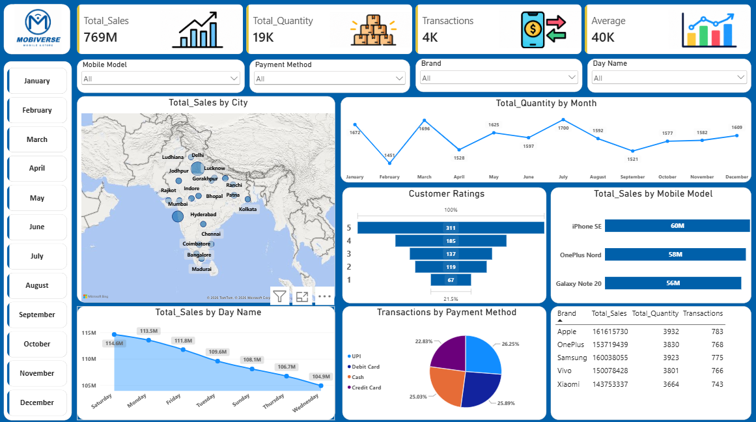
Mobile Sales Analysis Dashboard
DATA ANALYSIS PROJECT
Turning 3,835 transactions into clear sales insights across 19 Indian cities
Power BI
Power Query
Excel
Presented by Diptaraj Chakraborty

Slide 2




What is driving our mobile sales?
01 BUSINESS PROBLEM
Key questions the dashboard answers
THE CHALLENGE
A mobile retailer sells 5 brands across 19 cities, yet its sales sit in thousands of raw rows. There is no single view of what sells, where, when and how customers pay.
Which brands and models drive revenue?
Which cities and days bring the most sales?
How do sales units move month by month?
How do customers pay, and how do they rate us?
3,835
5
15
19
2021–24
transactions
brands
mobile models
cities
period covered

Slide 3



Sales Performance Dashboard
02 THE DASHBOARD
Raw data
Excel sales file with 3,835 transactions
Power Query
Cleaned and standardised, e.g. day names (Sat to Saturday)
Power BI
4 KPI cards, 7 visuals, 4 slicers and month buttons

Slide 4




Headline numbers
03 READINGS FROM THE DASHBOARD
₹769M
19K
4K
₹40K
Total Sales
Total Quantity
Transactions
Average
Revenue across 2021 to 2024
19,150 phones sold
3,835 individual orders
Average selling price per unit
₹200K
5 units
5 brands
average sales per transaction
average per transaction
15 models in 19 cities

Slide 5
When sales happen
03 READINGS FROM THE DASHBOARD
Total Quantity by Month (units)
Total Sales by Day Name (₹M)
Units peak in July (1,700), March and January. February is the low at 1,451, about 9% below the monthly average.
Saturday leads with ₹114.6M and Wednesday trails at ₹104.9M. The best-to-worst day gap is only about 9%.

Slide 6
Brands, payments and ratings
03 READINGS FROM THE DASHBOARD
Total Sales by Brand (₹M)
Transactions by Payment (%)
Customer Ratings (count)
Apple leads at ₹161.6M. Xiaomi is last at ₹143.8M, only 12% behind.
UPI is the top method at 26.25%. Credit card trails at 22.83%.
5-star is the biggest group. About 61% of ratings are 4 or 5 stars.

Slide 7
Where sales come from
03 READINGS FROM THE DASHBOARD
Top 6 cities by Total Sales (₹M)
Top 3 mobile models by sales
1
iPhone SE
₹60M
2
OnePlus Nord
₹58M
3
Galaxy Note 20
₹56M
43%
of total sales come from just two cities: Delhi and Mumbai

Slide 8




What the data tells us
04 BUSINESS INSIGHTS
Two metros carry the business
No single brand dependence
Delhi and Mumbai deliver 43% of revenue. The other 17 cities contribute only ₹23M to ₹31M each.
Apple leads with about 21%, but all five brands sit within 12% of each other. Top models earn ₹53M to ₹60M.
Steady demand, no festive spike
Payments and ratings have room
Monthly units stay between 1,451 and 1,700. Oct to Dec look like any other month. Saturday is strongest, Wednesday weakest.
UPI leads at 26% while credit card lags at 23%. About 1 in 5 ratings is only 1 or 2 stars.

Slide 9
What the business should do next
04 SUGGESTIONS
1
Grow beyond Delhi and Mumbai
Pilot targeted offers and stock in Ranchi, Chennai, Rajkot and Jodhpur, the next-best cities.
2
Build a festive-season push
Launch exchange and bundle offers for Oct to Dec, when sales are currently flat.
3
Time promotions around the week
Run flash deals on Wednesday and Thursday. Stock up for Friday to Monday.
4
Nudge payment behaviour
Reward UPI with cashback and add no-cost EMI to lift the 22.8% credit card share.
5
Back winners, fix laggards
Push iPhone SE, OnePlus Nord and Note 20. Review Redmi 9 and Vivo S1, and follow up on 1 to 2 star orders.

Slide 10
Conclusion
05 CONCLUSION
The business is healthy and well balanced: ₹769M from 19K units with no brand dependence. The next stage of growth depends on broadening beyond two metros, lifting off-peak periods and improving the payment and satisfaction experience.
43%
12%
61%
of sales from Delhi and Mumbai
spread between top and bottom brand
of ratings are 4 or 5 stars
TOOLS AND SKILLS
Power BI
Power Query
Data Cleaning
KPI Reporting
Data Visualization
Excel

